Slide 1
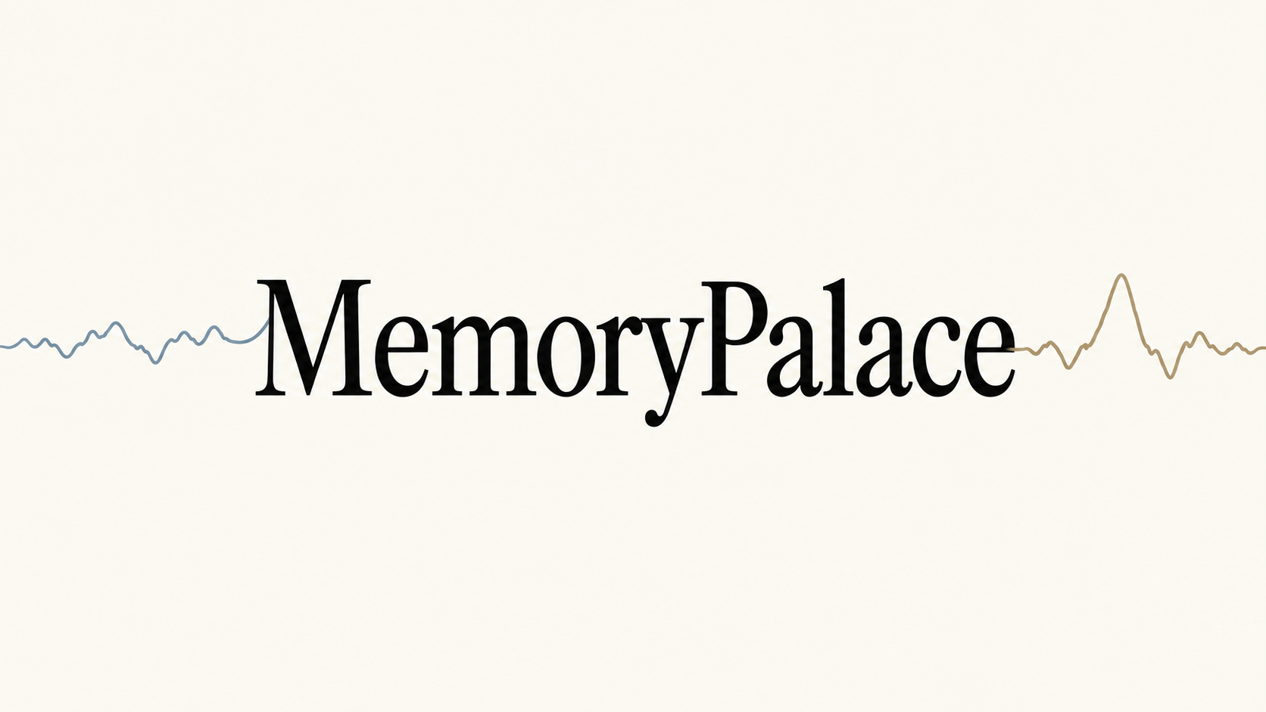
Revisit & Reflect’ | Mental Health is Physical Wealth
HackMIT 2026
Notes:
Memorypalace. Revisit the moments you almost forgot. A personal memory companion that links changes in EEG activity with recorded context. Begin the 36-second film on the next slide.

Slide 2
Ever walked into a room…
and forgotten what you came to say?
Our objective
Revisit recorded moments, reflect on your day,
and share selected experiences with close ones.
Notes:
Open with an everyday lapse in recall, not a medical claim. This is a relatable motivation, not evidence that an EEG detector identifies forgetting. Transition to the concept film.

Slide 3
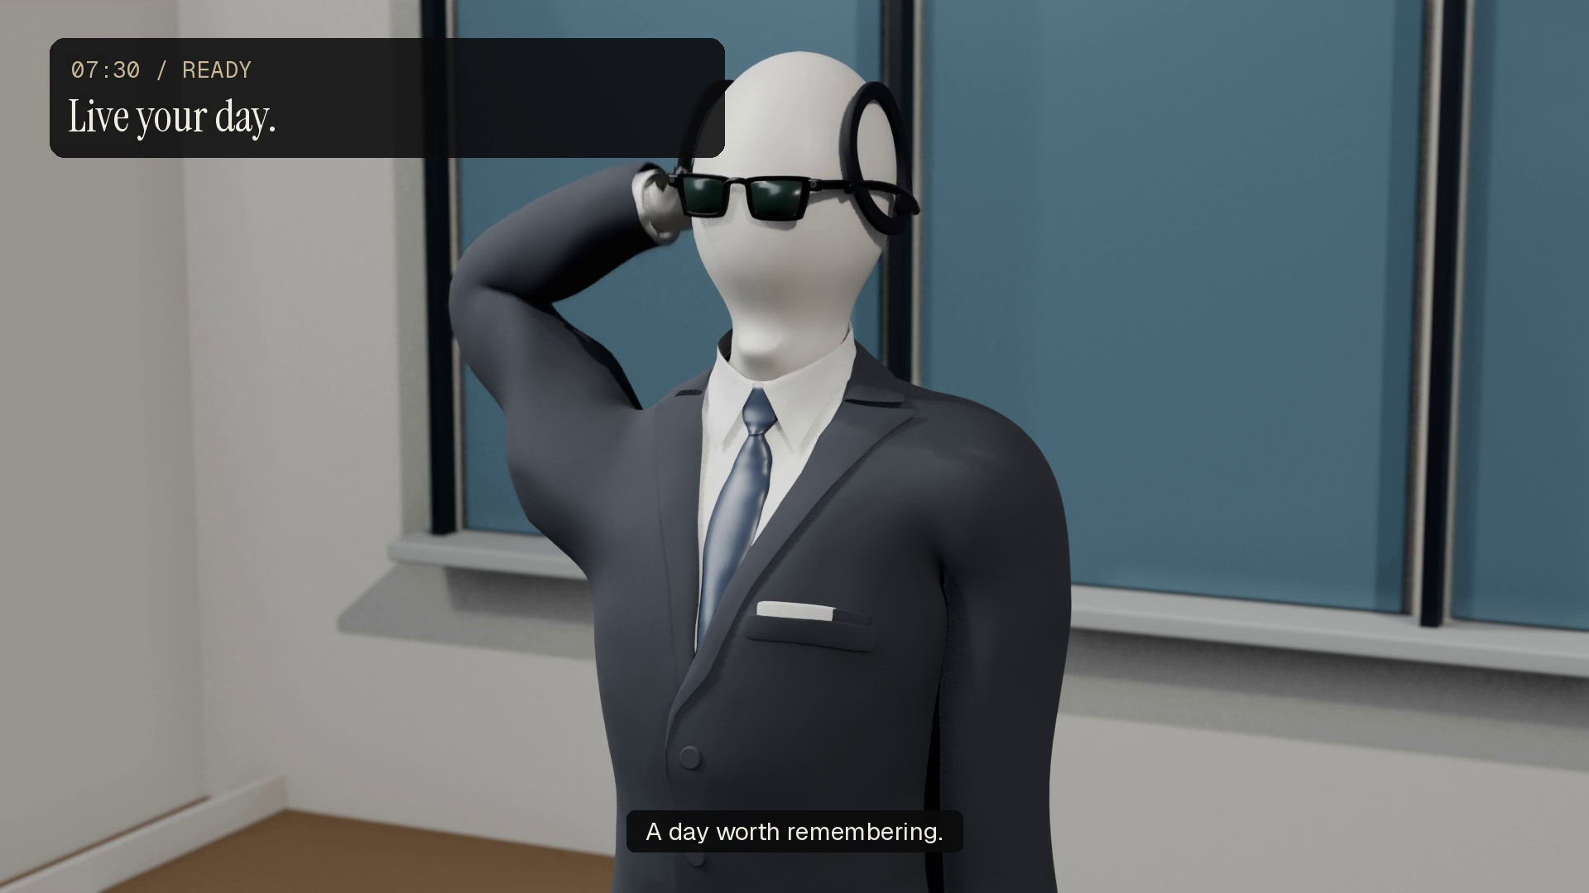
Notes:
Play the embedded 36-second concept film with sound. It illustrates the intended wearable experience, using the approved mannequin and revised desk reaction. The neural strengths shown in the film are illustrative story values. The running prototype uses the phone camera and supports synthetic EEG replay plus a Crown adapter.

Slide 4
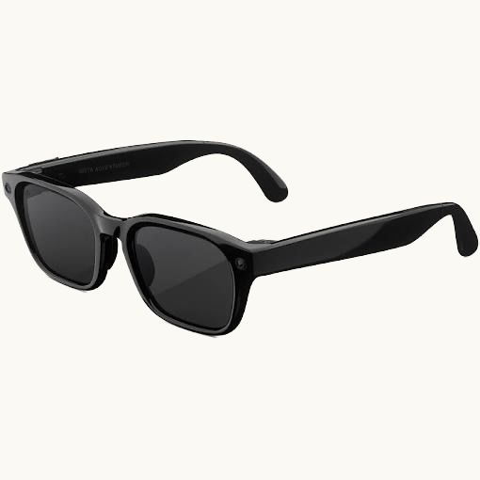
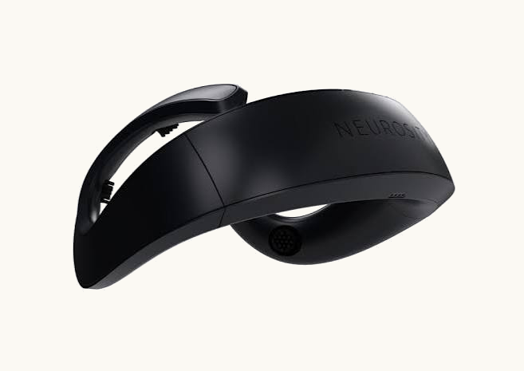
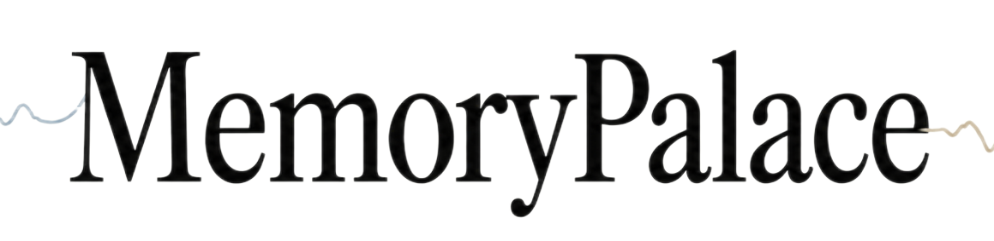
THE SYSTEM
Sense it. Capture it. Come back to it.
TRIGGER
INDEX
Sense (EEG)
Capture
Revisit
Neurosity Crown, against your baseline.
Ray-Ban Meta, only when it matters.
Memorypalace. Search, reflect, share.
The prototype records with a phone camera; the Crown adapter is implemented.
Notes:
Walk it left to right and say the three verbs. Crown senses, the trigger fires, the glasses capture, the app lets you revisit. Crown is an EEG sensor, not a neurostimulation device, and Ray-Ban Meta glasses are not Quest. The working prototype records with an Android phone camera and has a Crown stream adapter. Sources: hardware-demo/eegdemo/pipeline.py; neurosity.co/crown; wearables.developer.meta.com.

Slide 5
WHY THIS IS DIFFERENT
The field chased the hard problem.
We took the useful one.
FIELD: DECODING WHAT YOU FEEL OR THINK
US: DETECTING THAT SOMETHING CHANGED
SEED benchmark: 15 people, 2 sessions a week apart, 62 electrodes.
Motor imagery BCIs need 200 to 288 calibration trials per person.
Naming a feeling needs dense coverage and much labelled data.
We detect change, never the feeling.
120 seconds of calibration, once.
8 electrodes: 0.763 AUC. 16: 0.778.
Zheng & Lu, IEEE TAMD 7(3), 2015 • Wang et al., Front. Neurosci. 15, 2021 • CHANNELS.md
Notes:
The novelty argument, and every number on it is citable. SEED is the standard emotion EEG benchmark: Zheng and Lu, IEEE Transactions on Autonomous Mental Development 7(3), 2015. Fifteen subjects, two sessions a week or more apart, fifteen film clips of about four minutes, 62 channels. Wang et al., Frontiers in Neuroscience 15, 2021, doi 10.3389/fnins.2021.733546, tabulates 200 to 288 calibration trials per subject for motor imagery and uses the phrase long and tedious calibration time. Our contrast: we never name the feeling, so we need a threshold rather than a decoder.

Slide 6
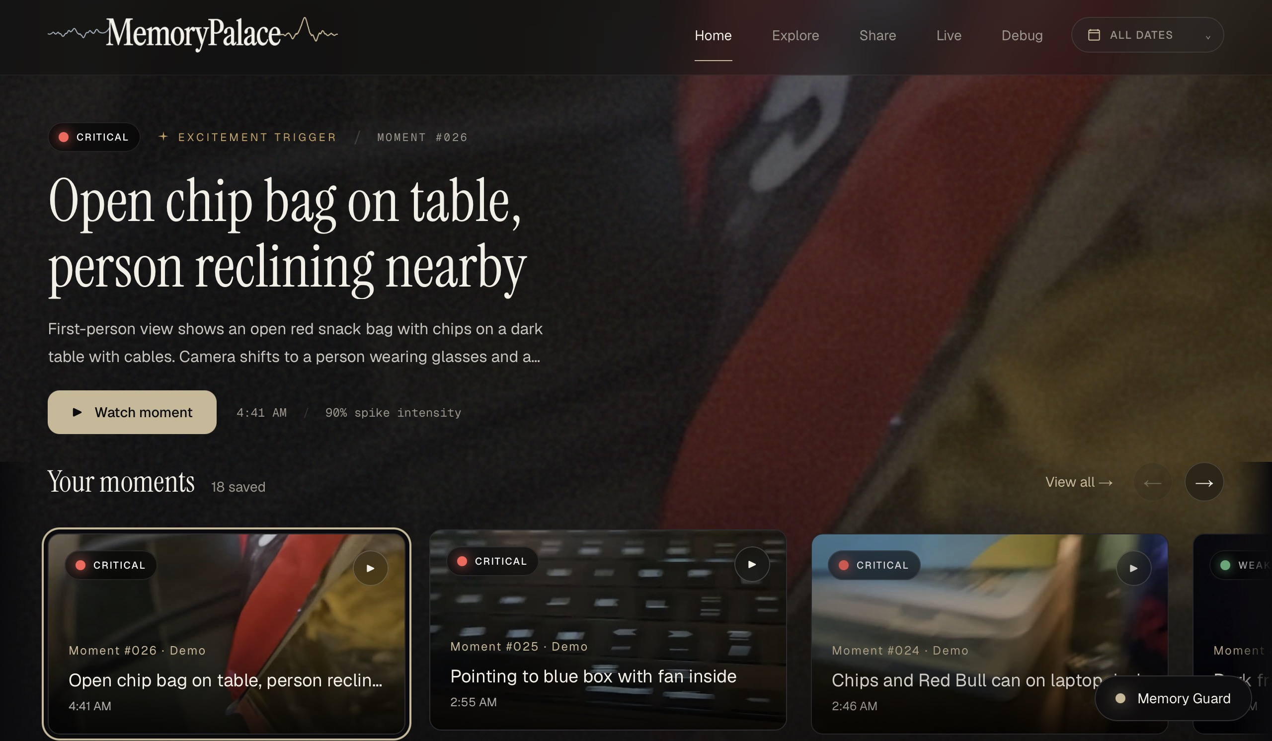
Remember one detail.
Get the whole moment back.
Search a fragment
One detail you remember.
Get the clip back
Opens where it fired.
Nothing was staged
Real app, captured live.
Notes:
Live demo at http://localhost:3000/explore. Query: laptop keyboard. The screenshot is captured from the running project, not a fabricated interface. Elastic combines keyword and vector retrieval, with timeline and intensity filters. Sources: app/components/explore; hardware-demo/eegdemo/elastic_store.py. Keep the standalone app running when using the demo link.

Slide 7
Reflection, for the moments you miss.
Healthcare track • the everyday case, and the one that will not speak up.
EVERY DAY
CHILDREN
Journaling, without the writing.
When a child will not say it.
A meeting that went badly. A conversation that turned.
Children under-report. A hard hour at school passes unmentioned.
You do not have to remember to record it. Your own EEG left your own baseline, and the clip was kept.
The headband flags that their baseline moved. It does not name a feeling.
A parent gets a moment to ask about, never a diagnosis.
Look at it that evening, when you have the room to think.
Sensing stays on the headband. Our own data rules out electrodes in the frames.
You decide what stays and what is deleted.
Glasses electrode positions rank 118, 119 and 120 of 120 pairs • confusion-detector/CHANNELS.md
Notes:
Healthcare track, part one. Two of the three pillars. Everyday reflection is the base case: you do not have to remember to record the meeting that went badly, because the trigger is your own EEG leaving your own baseline, and the clip is already kept. Children is the case for someone who will not raise it themselves: a hard hour at school that never gets mentioned. Be precise on stage: we flag that the baseline moved. We do not name a feeling, and we do not diagnose. The parent gets a moment to ask about. Note the hardware honesty: sensing stays on the headband, because our own electrode ablation puts glasses positions at ranks 118, 119 and 120 out of 120 pairs. If someone asks about electrodes in the frames, the answer is that we measured it and ruled it out. Sources: confusion-detector/CHANNELS.md, root README.md limitations.

Slide 8

A memory aid, and one trusted person
Healthcare track • dementia care, and the honest distance we still have to cover.
DEMENTIA
The minutes around a lapse.
Disorientation is frightening, and almost impossible to describe afterwards.
The wearer names one trusted person: a carer, or their clinician.
That person receives the moment. Not a live feed, not a dashboard.
Precedent: wearable camera review improved memory in Alzheimer's patients. Memory 23(3), 2015.
WHY IT IS WORTH BUILDING
The hard part of a memory aid is knowing which minute to keep. That is the part we measured, on public data, before we built anything around it.
Berry et al., Memory 19(7), 2011 • Alzheimer's study, Memory 23(3), 2015 • root README.md, limitations
Notes:
Healthcare track, part two, and the pillar that needs the most care. Dementia. The wearer names one trusted person, a carer or their clinician, and that person receives the moment after the fact. It is not a live feed and it is not a dashboard. The precedent is real and published: wearable camera review improved autobiographical memory in patients with Alzheimer's disease, Memory 23(3), 2015, and the wider SenseCam literature is Berry et al., Memory 19(7), 2011. Say the right-hand card out loud rather than skipping it. No patient has worn this, every end-to-end run in this repo used synthetic EEG, and the next step is a study with ethics approval and an outcome measure, not a launch. Saying that first is what stops a healthcare judge from assuming we do not know where the medical-device line sits. The system records context; a clinician reads it. It does not monitor, alert or diagnose.

Slide 9
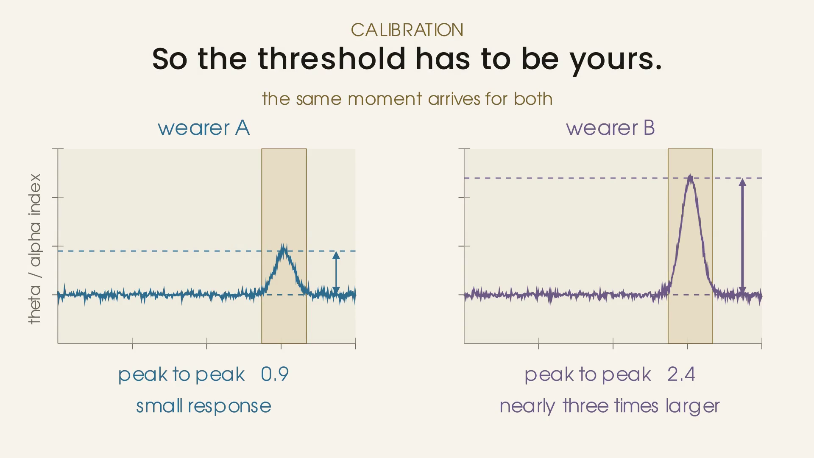
Your baseline makes the signal meaningful
The same reading can be unusual for one person and normal for another.
Same raw value.
Different meaning.
A: unusual change
B: within usual range
Illustrative example • the current baseline routine collects 120 seconds of EEG
Notes:
Illustrative arithmetic: raw theta/alpha index 3.0; A mean 1.0 and standard deviation 0.5 gives z=4.0; B mean 2.6 and standard deviation 0.5 gives z=0.8. These are explanatory values, not measured people or clinical thresholds. The implemented trigger threshold is z=2.0. Source: confusion-detector/src/detector.py and config.py. The chart remains editable beneath its animated video overlay.

Slide 10

Start by learning your normal
Raw amplitude varies with skull impedance and electrode contact. Our 30-second calibration maps personal resting spectral power to an individual $Z$-score baseline—enabling consistent event detection across any wearer.
20 µV Baseline (Low Gain)
Normalized Baseline: z = 0.0
40 µV Baseline ( Medium Gain)
Normalized Baseline: z = 0.0
70 µV Baseline (High Gain)
Normalized Baseline: z = 0.0
Different ranges. A baseline that belongs to you.
Notes:
The three raw EEG traces and 20 / 40 / 70 microvolt ranges are synthetic illustrations, not measured people or diagnostic norms. Peak-to-peak means maximum minus minimum; raw amplitude also depends on recording conditions. The live prototype calibrates theta/alpha mean and spread over 120 seconds, then uses a z-score. It does not trigger from raw peak-to-peak amplitude. Person icon: Lucide user-round, https://github.com/lucide-icons/lucide/blob/main/icons/user-round.svg (ISC).

Slide 11
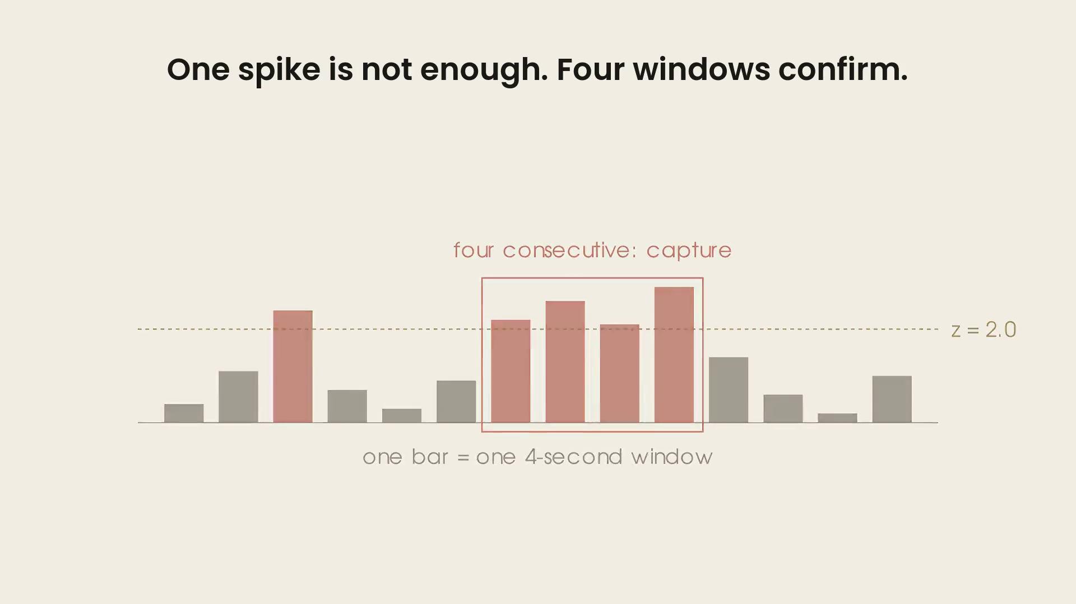
Four fresh windows confirm one event
Removing signal noise
Each window uses new EEG samples. A dip below the threshold resets the count.
0–4 s
4–8 s
8–12 s
12–16 s
Elevated
Elevated
Elevated
Elevated
4 / 4 confirmed
Flag the moment
Current detector: 4-second non-overlapping windows • illustrative signal sequence
Notes:
Four consecutive windows above z=2.0 are required. No overlap means samples are not reused; it does not prove statistical independence of brain activity. The active backend finalizes an ongoing recording on this trigger, attaches the signal context, and saves it. The concept film illustrates the broader event-capture vision. Sources: confusion-detector/src/config.py; hardware-demo/eegdemo/server.py Runtime.trigger.

Slide 12
Every check uses data it has never seen
Fresh samples reduce false alarms.
Controlled synthetic fixture • same data and threshold • source: confusion-detector/README.md
Notes:
Controlled comparison reported in confusion-detector/README.md, The one result that matters: 4-second windows, 75% overlap (hop 1s) 30.3 false alarms/hour; 50% overlap (hop 2s) 18.9; no overlap (hop 4s) 1.3. Same stationary synthetic fixture and threshold. Do not generalize the absolute rate to people or drifting baselines; the drifting fixture reported 7.2/hour at the default setting. This chart is engineering evidence for avoiding repeated samples, not a clinical performance claim.

Slide 13
Five datasets. One question.
4 public corpora and our own. Can scalp EEG mark a state change?
Shin et al. 2018 • dataset A
OpenNeuro ds006394
28 channels • 5 people • 15 sessions • labels unmodified
16 channels • 33 people • 51 recordings
Task versus rest during n-back. This is the model we ship: 79% mean AUC, and 8 of 15 sessions beat their own time-shift null.
Surprise versus dummy surprise. This chose our hardware.
PhysioNet EEGMMIDB
PhysioNet Auditory EEG
Our own Emotiv EPOC X
64 channels • 109 people • 278 MB
4 channels • 20 people • 476 MB
14 channels • 192 trials • committed
Crown's exact eight channel names, no substitution.
A real four electrode montage. Split by recording, never at random.
Three class imagery 65.8%, chance 33.3%, shuffled control 34.8%.
167 people, 1.3 GB, labels untouched • public data validates the machinery, it never supplies the deployed weights • dataset/README.md
Notes:
Voloridge asked for something interesting built on public data. We opened five public EEG corpora and one of our own. Shin et al. 2018 dataset A gave the state detector we ship. OpenNeuro ds006394, 33 people at 16 channels, decided the hardware. PhysioNet EEGMMIDB let us test the Crown's exact eight channel names with zero substitution. PhysioNet Auditory EEG, four real electrodes, is where we learned that random epoch splits lie and every split must be at recording level. BED is the only corpus with sessions a week apart and it is access-restricted, so we did not download it and we claim nothing from it. Our own Emotiv EPOC X recording is committed to the repo: 192 trials, 65.79% three-class against 33.3% chance, shuffled-label control at 34.79%. Labels are always the experimenters', never invented. Public data validates the machinery; it never supplies deployed weights, because spatial filters are tied to electrode positions and impedances. Sources: dataset/README.md, eeg-state-detection/README.md, confusion-detector/CHANNELS.md, eeg-neural-signal-processing/RESULTS.md.

Slide 14
84 numbers. Eight electrodes.
The simplest model that won, and the smallest montage that keeps it.
What survived
How few electrodes, and where
28 EEG channels, 200 Hz
Mean AUC on ds006394 • n = 38 recordings • chance 50%
Shin et al. 2018, unmodified labels
16 electrodes
84%
Regress out the eye channels
full scalp
Fit before the task, frozen before scoring
8 electrodes
82%
Crown-like headband
Theta / alpha / beta log power
WE SHIP THIS · 98% OF 16
84 features • 2 s windows, every 0.25 s
4 electrodes
76%
Logistic regression, then one moving average
Fz Cz F7 F8
Task versus rest • one smoothing parameter
2 electrodes
76%
midline • Fz Cz
Seven richer alternatives lost or tied
2 electrodes
63%
glasses brow • Fp1 Fp2
Riemannian 1,218 features • Fourier 728 • zigzag topology 108 • Bayesian state space
Every one of the top 12 pairs of 120 contains Cz or Fz. One well placed pair beats four badly placed ones.
Not a 128 channel pipeline • 8 dry electrodes hold 98% of the full montage • Final Presentation/README.md
Notes:
Left side is the model. 28 channels at 200 Hz, eye channels regressed out with the filter fit before the task and frozen before scoring, log power in theta, alpha and beta, 84 features from 2-second windows every 0.25 s, logistic regression, one moving average. Seven richer alternatives were tested as paired comparisons on the same recordings and folds: Riemannian tangent space at 1,218 features, two Fourier variants, zigzag persistent homology, a Bayesian state-space model, an adaptive IMM variant and EWMA volatility. Every one lost or tied. Right side is the sensor-agnostic question, measured within subject on ds006394 where chance is 0.50. 16 electrodes 0.778, Crown-like 8 electrodes 0.763, Ganglion 4 electrodes 0.719, midline Fz plus Cz 0.719, glasses brow 0.606. Eight dry electrodes hold 98% of the full montage. Every one of the top 12 pairs out of 120 contains Cz or Fz, and Cz plus O1 at 0.745 beats the whole four-channel Ganglion set. So it is not how many electrodes, it is where. Caveat worth saying aloud: a detector calibrated on visual surprise falls to 0.634 on the same person's auditory task, so calibrate on the task you will actually run. Source: confusion-detector/CHANNELS.md.

Slide 15
More complexity did not win
Seven alternatives, each paired against its own baseline
What we tried
And three more
Riemannian tangent space
Adaptive switching model
0.781 vs 0.791
1,218 features • 22.2 s of rest against 2.0 s
EWMA volatility features
Worse accuracy
26-bin Fourier spectrum
Broad-band Fourier power
A tie
728 features • accuracy 0.541 against 0.635
Zigzag persistent homology
Band power + logistic regression
108 features • p = 0.13 against random flags
84 features • the only addition we kept
Bayesian state-space model
Latent state + AR(1) noise • 0.739 against 0.791
Rows are different participants • each valid only against its own baseline, never as a leaderboard
Notes:
We did not start simple and stop there. Every one of these was tested on the same recordings, the same windows and the same calibration folds as the baseline it is being compared against. Riemannian geometry recovered more whole tasks but flagged twenty-two seconds of rest against two. Topological data analysis looked three times better than its baseline until we tested it against random placement. Bayesian state-space models lost to a plain moving average. Every one lost or tied. The only thing we kept is a single smoothing half-life. One number. Because rows are different participants, this is deliberately not a leaderboard: each row is only valid against its own baseline.

Slide 16
Two questions. Two datasets.
Voloridge • public corpora, the authors' own labels, models frozen before scoring.
Does it work across people?
How many electrodes, and where?
Shin 2018 • 28 channels • 5 people • 3 sessions each
OpenNeuro ds006394 • 16-channel OpenBCI • n = 38 recordings
PARTICIPANT
MEAN AUC
BEAT THEIR NULL
ELECTRODES
WHERE
MEAN AUC
VP002
93%
3 of 3
16
Full scalp
84%
VP005
89%
2 of 3
8
Scalp, Crown-like
82%
VP003
80%
1 of 3
2
Fz, Cz
76%
VP006
67%
1 of 3
4
Fz Cz F7 F8
76%
2
F3, F4
73%
4
On glasses
65%
2
Glasses brow
63%
79% mean AUC across 15 sessions. 14 of 15 above chance. The spread is why the model is trained per person.
2
Glasses temples
61%
Halving the electrodes costs 2 points. Moving them to the temples costs 21.
Chance = 50% • n = 38 of 51 recordings, those where the full montage cleared 0.70 AUC • Final Presentation/README.md
Notes:
Two questions, two public datasets, both tables straight out of Final Presentation/README.md. Left: does it work across people? Shin 2018, 28 channels, five participants, three sessions each, calibrate on the first six blocks and score the last three with models frozen before scoring. VP002 at 93% down to VP004 at 65%, 79% mean across all 15 sessions, 14 of 15 above chance, 8 beating their own circular time-shift null at p <= 0.05. The spread is the argument for per-person training. Right: how many electrodes and where, on OpenNeuro ds006394, within subject, n = 38 of 51 recordings, the ones where the full montage cleared 0.70 AUC; the 13 excluded are named in figures/inclusion.json. The headline is that halving the electrodes costs 2 points and moving them to the temples costs 21. Chance is 50%. These are AUC, not accuracy: 84% AUC means the model ranks a true event above a non-event 84% of the time.

Slide 17
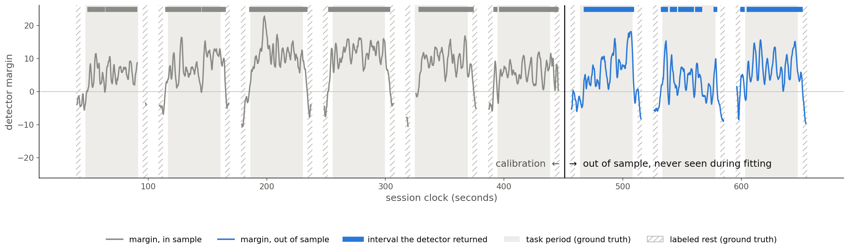
What the detector actually does
VP002, session 3 - six blocks calibrate, the last three are scored
Margin rises during the task, falls during rest. Blue is out of sample: never seen while fitting.
Notes:
This is one session of one participant, and it is the clearest picture of what the detector does. Grey on the left is the six calibration blocks. Blue on the right is the three blocks it never saw while fitting. Shaded bands are the real task periods and the hatched bands are labelled rest, both from the experimenters' markers. The margin climbs through every task block and falls below zero during rest, and the out-of-sample half behaves like the calibration half. The bars along the top are the intervals the detector actually returned. This session scores 0.97 out of sample, and against the shift null that is below a thousandth. It is our strongest session; the next slide shows all fifteen, including the weak ones.

Slide 18

Elasticsearch is the memory.
Sponsor challenge: turn complex, messy data into insights, answers or actions.
Moment
Elastic Inference
One index
Hybrid retrieval
Filters
10 s clip, 8 channel band powers, IMU and timestamp
Jina v5 Omni embeds the video itself, no transcript
1,024 dim cosine vector beside BM25 text
BM25 and dense kNN fused by RRF
Confidence band, event type, time range
LIVE
Elastic Cloud Serverless
The whole index runs there. 12 moments live and complete.
LIVE
Jina v5 Omni embeddings
Video embedded directly. A text fallback is recorded, never hidden.
LIVE
Hybrid semantic search
A live 'laptop keyboard' query returned the keyboard moment first.
NEXT
Workflows and Agent Builder
Baseline normalisation and a recall agent. Designed, not yet built.
Semantic and vector indexing is the backbone, not a bolt-on.
Index memorypalace-multimodal-moments • .jina-embeddings-v5-omni-small • eegdemo/elastic_store.py
Notes:
Challenge source: DOCS_sponsor/elastic. Implementation: Elastic Cloud Serverless, Jina v5 Omni via Elastic Inference, semantic metadata, BM25 + dense kNN with RRF, date and EEG-intensity filters. The persisted video is linked from the retrieved moment. Sources: hardware-demo/eegdemo/elastic_store.py; FULFILLMENT_SPONSORS.md. Logo source: https://www.apmdigest.com/sites/default/files/2024-09/logo_elastic.png ; brand owner https://www.elastic.co/ . Official method references: https://www.elastic.co/docs/solutions/search/multimodal-search ; https://www.elastic.co/docs/reference/elasticsearch/rest-apis/reciprocal-rank-fusion .

Slide 19

Meta sees it, hears you, answers.
Sponsor challenge: bring people closer together, with AI doing real work.
SEE
LIVE
GROUND
LIVE
HEAR
LIVE
Muse Spark 1.3
Muse Spark web search
Muse Voice Transcribe
Sent as input_video. Returns title, description, keywords, topics.
Public names verified before indexing. A hint is never proof.
Push to talk, 24 kHz mono, 30 s. Transcribed, then dropped.
ANSWER
LIVE
CAPTURE
DEMO
CONNECT
LIVE
Memory Guard, Muse Spark
Wearables Toolkit 0.9
Muse Spark
Reasons over what Elastic returned, and cites the clip to replay.
The pairing handoff is real. The phone camera records for now.
Send a day's highlights to the few people you choose.
A private day, made shareable with the people who matter.
Responses API and Muse Voice Transcribe are live in the build • the spoken answer uses the device speech synthesizer, not a Meta model
Notes:
Sponsor prompt: Bringing People Closer Together with AI. Muse Spark (muse-spark-1.3) is used in vision.py for recorded-video descriptions and in agent.py for Memory Guard reasoning/tool use and share_note generation. Muse Voice Transcribe (muse-voice-transcribe-1.0) transcribes push-to-talk input in voice.py; playback speech uses device speech synthesis. Muse Image and a Muse personal-agent connector are not implemented and are not claimed. Sources: hardware-demo/eegdemo/vision.py; agent.py; voice.py; app/components/share/SharePage.tsx. Sponsor links: https://developer.meta.com/ai/models/muse-spark/ and https://developer.meta.com/ai/models/muse-voice-transcribe/ .

Slide 20
LIVE
Demo time.
01
02
03
Search a fragment
Open the moment
Share it
One detail you remember, typed into the box.
The clip plays from where the signal fired.
One moment, to one person you chose.
Notes:
Demo. Keep it to three beats and do not narrate the UI. One: type a fragment you remember into search. Two: the moment opens and the clip plays from where the signal fired. Three: share that one moment with one person you chose. The share step is the Meta track's highest-weighted criterion, human connection at 30%, so do not cut it for time. The app runs locally at localhost:3000.

Slide 21
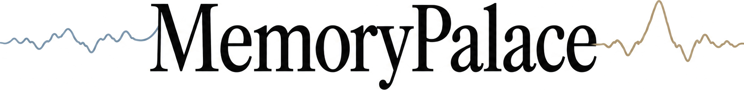
Your day has more to tell you.
Keep the context. Revisit it when you have time.
Notes:
Close: Memorypalace turns a fleeting reaction into a moment you can revisit, understand, and choose to share. Invite the judges to try the running retrieval demo. The film describes the wearable concept; the charts and sponsor slides show the implemented work.

